Slide 1

QM250 project presentation
Stdents names and id: (section:05)
1- mohaned nader 20170689
2-Abdullah Haggag 20195640
3- Malak hussain 20183299
4- Jenan Jehad 20174647
5- Anas Abdulaziz 20160419
6-roaya mohammed 20180926
7-husain mohamed 20186413
8- Manar Mohammed 20163633

Slide 2

The impact of tourism on the Economic Growth introduction:-
In this presentation we will talk about the impact of tourism on the economic growth ,Tourism is one of the activities that affect many other economic activities, such as restaurants hotels, transportation, and entertainment institutions.
Tourism is an important source of income for countries around the world, which makes tourism an important role in influencing national income, directly or indirectly.

Slide 3
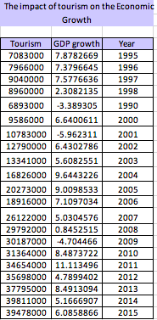
Section 1:
-At first we are Using the skills that we learned to apply to the analysis of this data for comparison the impact of tourism on the economy
- in this quantitative data , we see the difference in the number of tourists
-Tourism : International inbound tourists are the number of tourists who travel to a country other than that in which they have their usual residence, but outside their usual environment for a period not exceeding 12 months.
-GDP growth: Annual percentage growth rate of GDP at market prices based on constant local currency. GDP is the sum of gross value added by all resident producers in the economy plus any product access and minus any subsidies not included in the value of the products.

Slide 4


Section 2 :
Mean is average of a data set is found by adding all numbers in the data set and dividing by the total number of values in the data set. In our measurement the total mean of tourism is 21302761.9 total from the table in Excel.
The Standard Deviation is statistic that is used for measures amount of the variation of a set of values.
A low standard deviation is tend to close to the Mean we called the expected value of the set, while a high standard deviation tells us the values are spread out over a wider range. In our measurement the total standard deviation of tourism is 12055810.3. total from the table in Excel
The variance is the average of the squares of the distance each value is from the mean. In our measurement the total variance value of the tourism is 1.4534E+14. total from the table in Excel

Slide 5
Linear Regression
Simple linear regression is a model that assesses the relationship between a dependent variable and an independent variable. The simple linear model is expressed using the following equation:
Y = a + bX + ϵ
Where:
Y – Dependent variable (GDP)
X – Independent (Tourism)
variable
a – Intercept
b – Slope
ϵ – Residual (error)

Slide 6
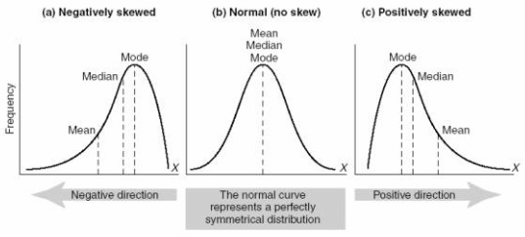
Section 3:
Further analyse and reflect on the shape of the graph.
-it seems that the Tourism rate increases in general comparison to the GDP rate, which increases at times and decreases in others. Also we can see a deep and sharp decreasing and high increasing in GDP rate opposite to Tourism rate.
the range and the standard deviation of the chosen data.
-Range / Tourism rate = 39811000 – 6893000 = 32918000 / GDP rate = 11.11-(-5.96) =17.07
- Standard deviation/
- In the first quarter we can see a slow increasing in Tourism rate, as for GDP rate it was stainable rate in the first three years but it decreased sharp and deep in last two years, in third quarter we can see a high increasing in Tourism rate but the GDP rate still dropped deep after its increased in second quarter.
The correlation coefficient is measured on a scale that varies from + 1 through 0 to – 1.
- So in Tourism rate almost r=1, but in GDP rate r=0.
the hypothesis for the impact of the independent variable by the dependent variable.
The independent variable is the cause. Its value is independent of other variables in your study.
The dependent variable is the effect. Its value depends on changes in the independent variable.
So as the graph, there are no binding between Tourism rate and GDP rate.
the regression equation.
- Y=a + bX + ∈

Slide 7

Section 4 :
The above summary output tells us that the value of correlation coefficient is 0.15 which indicates that there is a weak positive relationship between Tourism and GDP per capita growth. And the value of R² is 0.023 which represents that 0.23% variation has been explained by the independent variable (Tourism) in the total variation of dependent variable GDP per capita (%). It shows that this is not such a good fit model as the value of coefficient of determination is so far to 1. The standard error is 4.76 shows that the data is the more precise estimate of the population parameter.
As the results shows that p-value is greater than assumed alpha which is 0.05 so we accept or null hypothesis and interpret that regression coefficient is equal to zero.
The fitted regression equation is as; $\hat{Y}=$ 3.767 5.907E-08X, the intercept value is $\hat{α}=3.767$ indicates that the point distances from where the regression line passes through the origin and the slope value represents if we increase one unit in the mean value of independent variable (Tourism) than there will be minor increase in our dependent variable (GDP per capita).
Hypothesis testing for correlation coefficient:
$H_{o}:ρ=0$ (Population correlation coefficient is equal to zero).
$H_{1}:ρ≠0$ (Population correlation coefficient is not equal to zero).
Hypothesis testing for Regression:
$H_{o}:β=0$ (Regression coefficient is equal to zero).
$H_{1}:β≠0$ (Regression coefficient is not equal to zero).

Slide 8
Conclusion :
It was very clear from the data analysis that there is an impact of tourism on the economic growth.
The impacts of tourism become recognized over the time
The tourism rate is increases in comparison to the GDP
The impact of tourism is occurred either by direct way like sold of food and beverages services or indirect way through more investment on government or private sector created by tourism

Slide 9
THANK YOU

